Slide 1
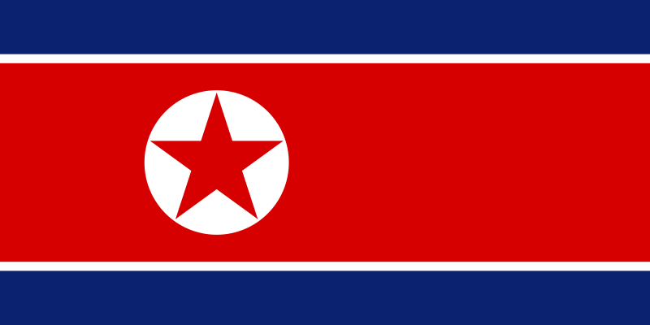
North Korea
Philip Dumaresq

Slide 2

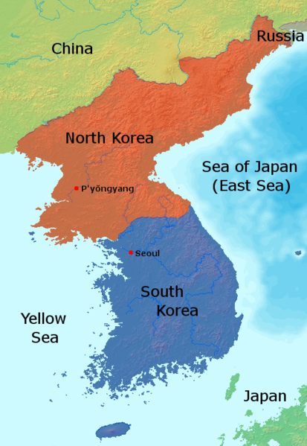
2 second history
North Korea was occupied by the Soviet union, with the south occupied by the Americans
The Soviet union and Americans pulled out of Korea in 1948-1948
North Korean invaded the south in 1950 out of fear that the south would do the same to them. Korean war begins.
North backed by Soviets and South by the UN, mostly the Americans.
Cease fire declared in 1953, Kim Il-Sung leading the country
Attempts were made to better relations with the west, but failed.
Kim Il-Sung died in 1994, followed by more failed negotiations from Kim Jong-Il
Kim Jon-Il died in 2011, succeeded by Kim Jong-Un

Slide 3
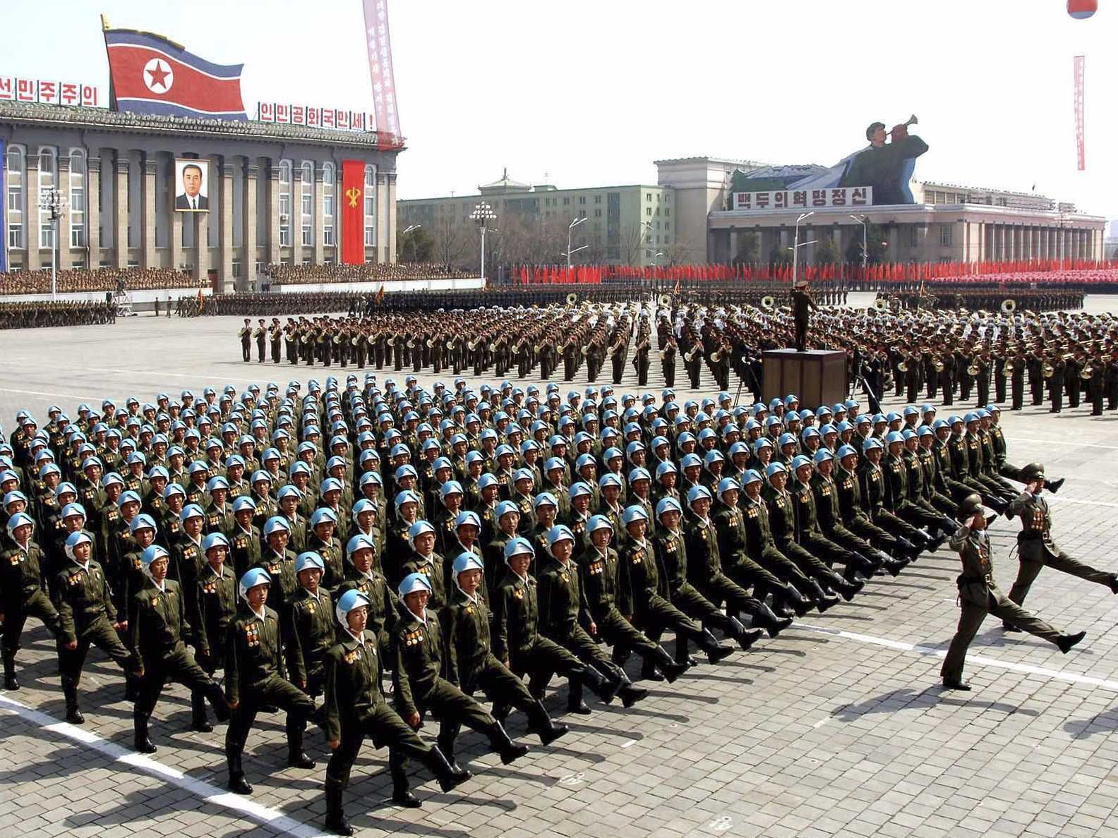
North Korea - Today
North Korea is a highly militarized society, isolating itself from the outside world.
Kim Jong-Un is the current North Korean premier, he tries to keep the people of North Korea believing in him.
North Korea tries to give off the image of power and sustainability to the rest of the world, but people who visit North Korea say otherwise.
North Korea is feared because they threaten those who depict an image of them other than what they depict of themselves.
North Korea is hostile to the western world, threatening war and developing weapons to fight one.
Missile tests in North Korea have been more and more common in the past few years, with one failed test just the other day in the news.

Slide 4
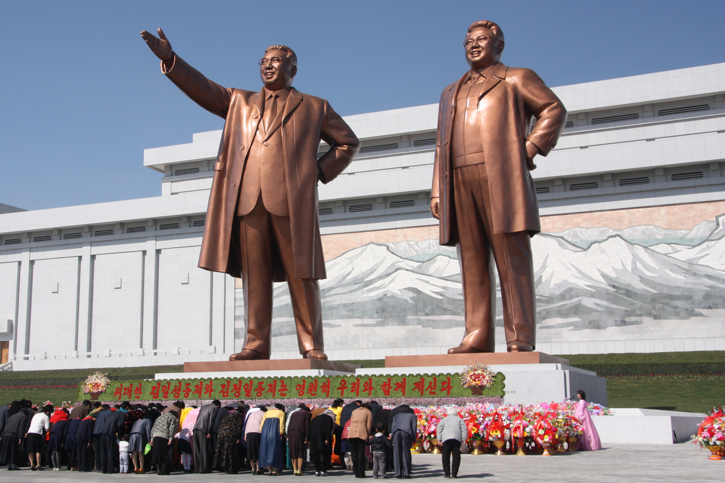
Culture
North Korea follows the Shogun principles – those of a military first society
North Korea tries to be completely independent as a nation to try and get it’s people to have a strong reliance and faith in the government.
Religion is publicly discouraged, although the Kim family is seen as all powerful and are treated religiously as a source of national propaganda.
Technically North Korea is a democratic society, but in function it’s a dictatorship.
The leadership of North Korea has been passed down through the Kim family, as though it could be treated like a dynasty.

Slide 5
National Narrative
North Korea presents itself as a country that is completely self reliant and very strong.
North Korea is a very patriotic country, the people are willing to fight to defend it, even if the people are treated poorly.
North Korea developed into this highly militarized society in the 1990’s when it suffered a terrible famine.
The collapse of the Soviet union meant that North Korea was no longer getting aid from them, sparking the beginning of the famine.
North Korea was forced to request humanitarian aid in 1995, and several countries such as South Korea and the US provided food.
In 2002, North Korea asked the aid to stop, with a rising black market and people becoming less reliant on the government and losing respect for the Kim family.

